Slide 1



Library Database Project

Slide 2

Member | Work Percentage
Shabir | 45%
Aqsa | 40%
Ali Aqsa | 10%
Nawid | 5%

Slide 3
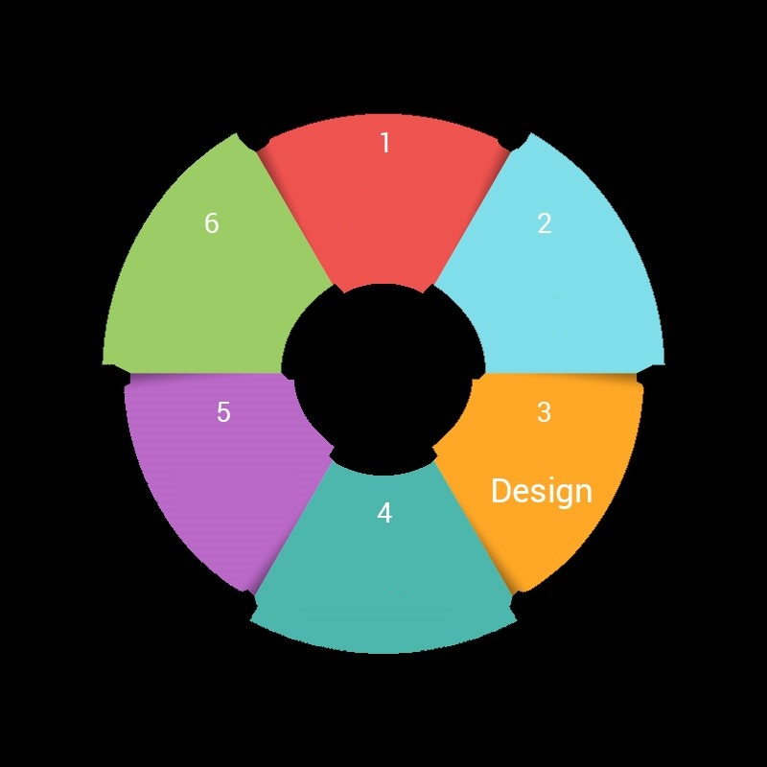
Agile methodology
Design the Tables
Test and Documentation
Create the ERD
Library Project
Create Front END
Create Tables and establish the relations
Create Sequence and triggers

Slide 4
Tasks
Sequence | Task | Responsible | Status
1st | Design Tables and entities | Nawid | Done
2nd | Specify the entities Constraints | Shabir | Done
3rd | Create ERD and document | Aqsa | Done
4th | create tables in DBMS | Shabir | Done
5th | Establish the relations between the tables | Shabir | Done
6th | Create Sequence | Aqsa | Done
7th | Insert data | Ali Aqa | Done
8th | search and apply normalization rolles | All | Done
9th | Search and create Traigers | Nawid | Done
10th | Praper queries with description | Aqsa | Done
11th | search about apex application for front making | Shabir | Done

Slide 5
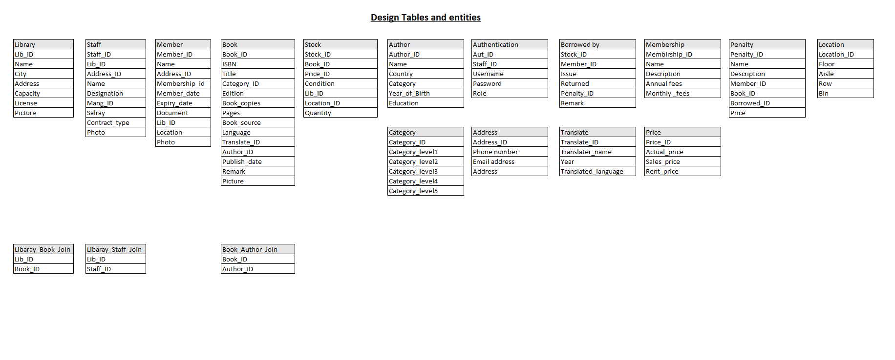
DATABASE DESIGN
The first step in the database was to Design Tables and entities.

Slide 6
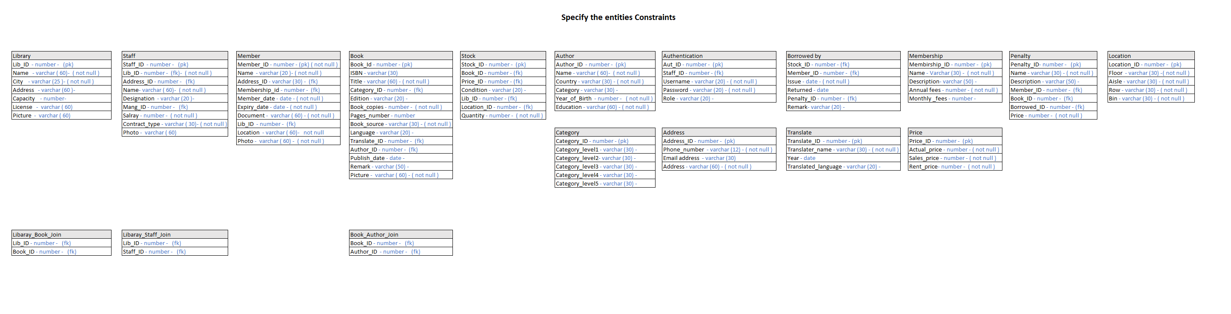
The Second step in the database was to Specify the entities Constraints

Slide 7
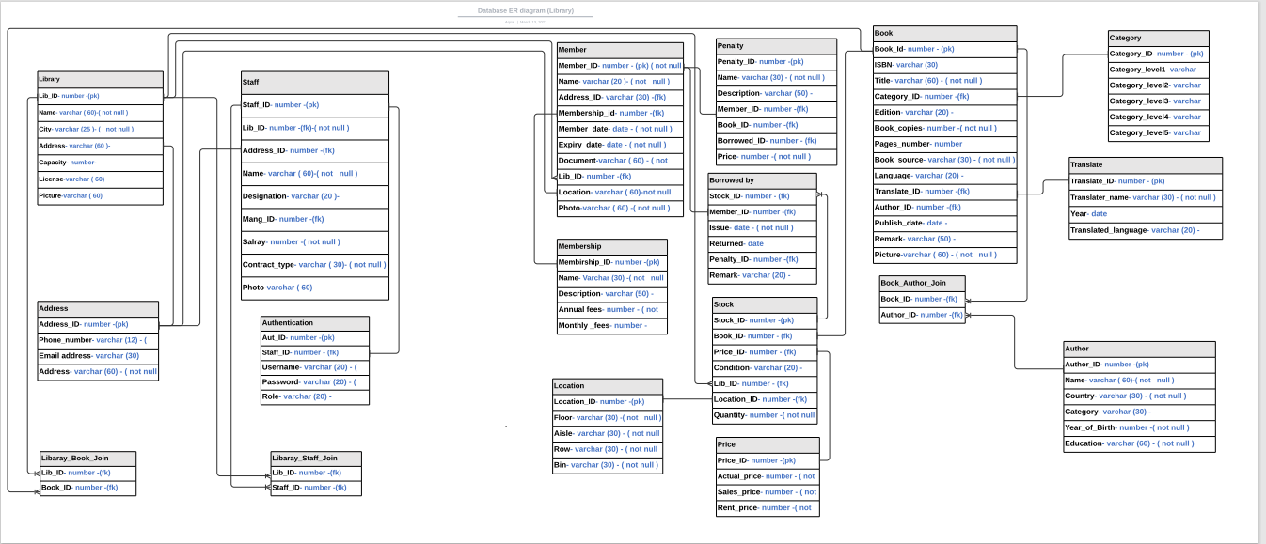
The Third step in the database was to Create ERD

Slide 8
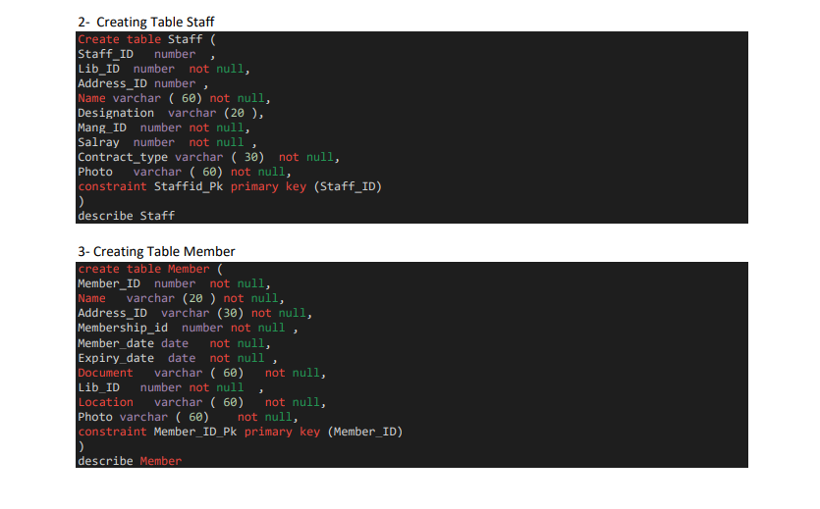
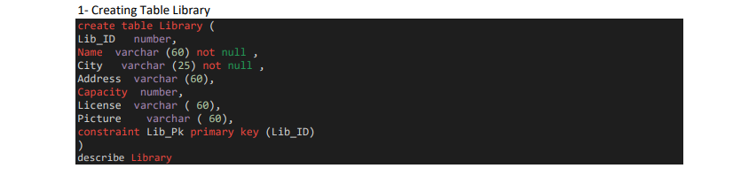
All Queries used in creating the Library Database Project Tables.
The Fourth step in the database was to create tables in DBMS

Slide 9
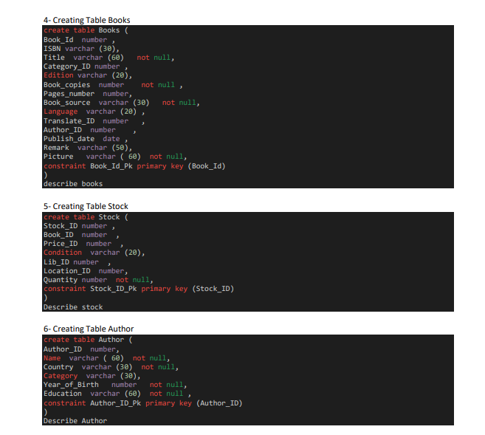

Slide 10
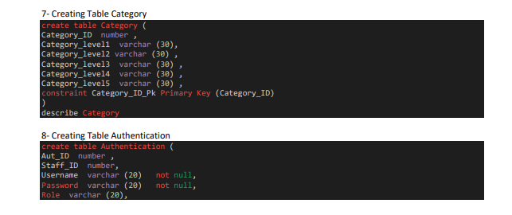
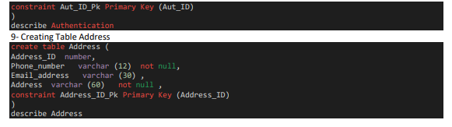

Slide 11
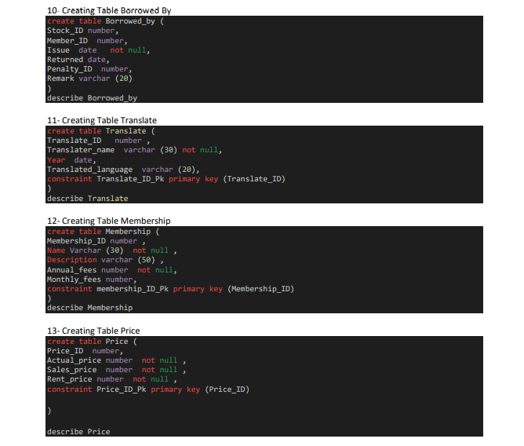

Slide 12
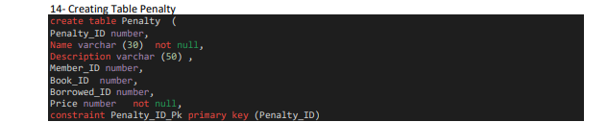
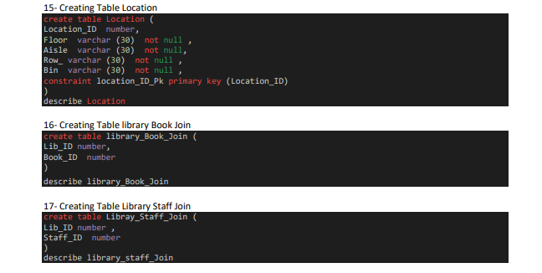

Slide 13
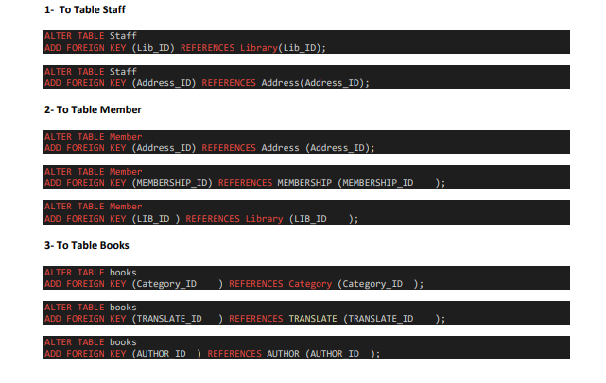
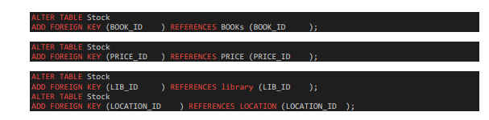
All quires used to establish relation between tables
The 5th step in the database was to establish relations between tables
4- To Table Stock

Slide 14
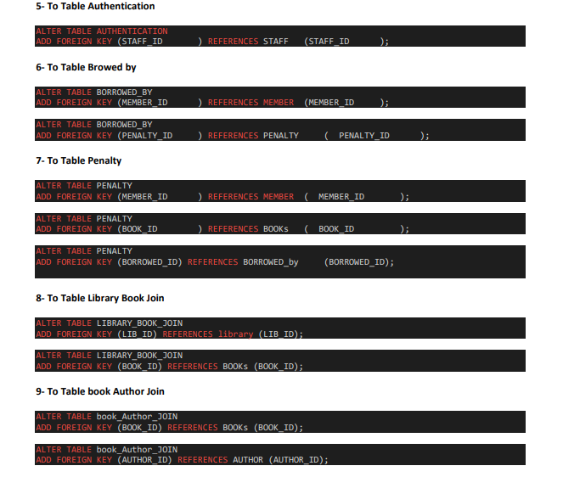
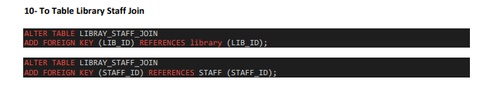

Slide 15
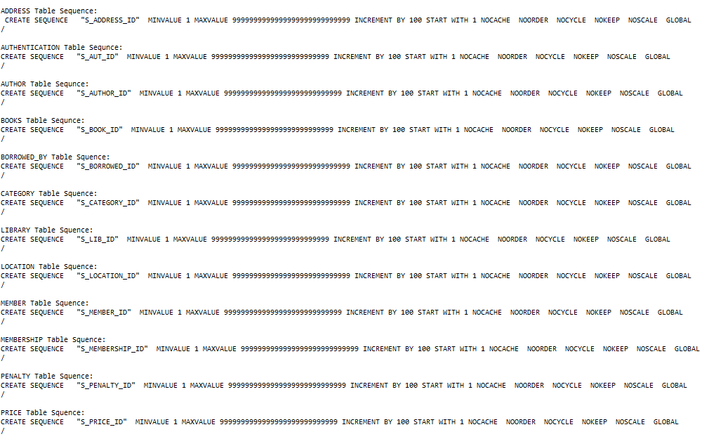
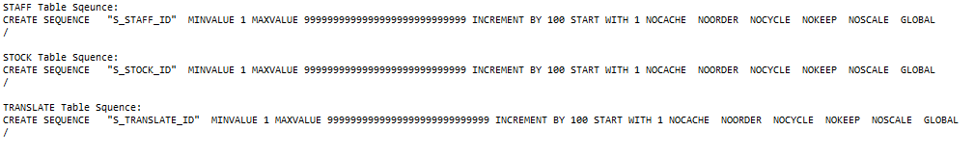
The 6th step in the database was to create sequence

Slide 16
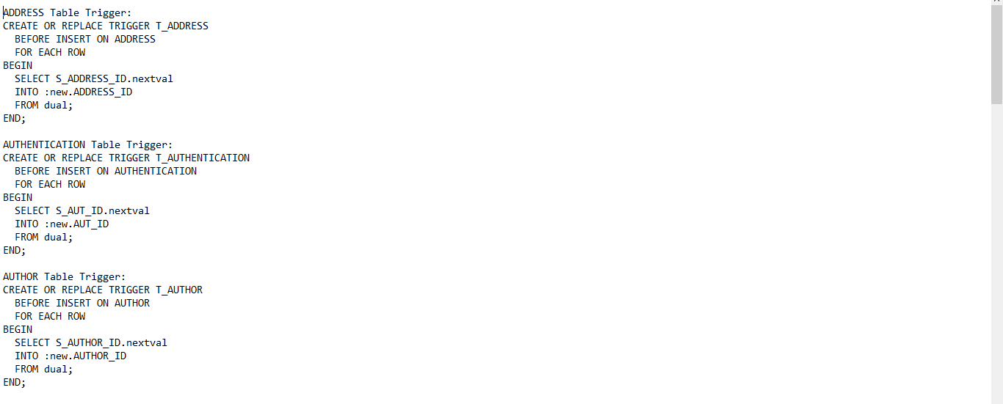
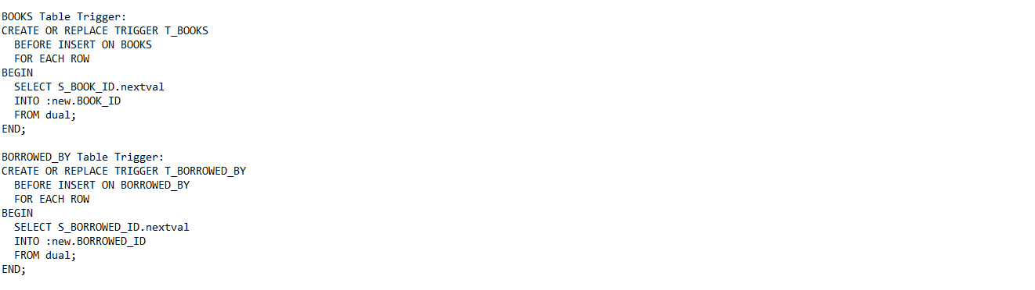
The 7th step in the database was to create triggers

Slide 17
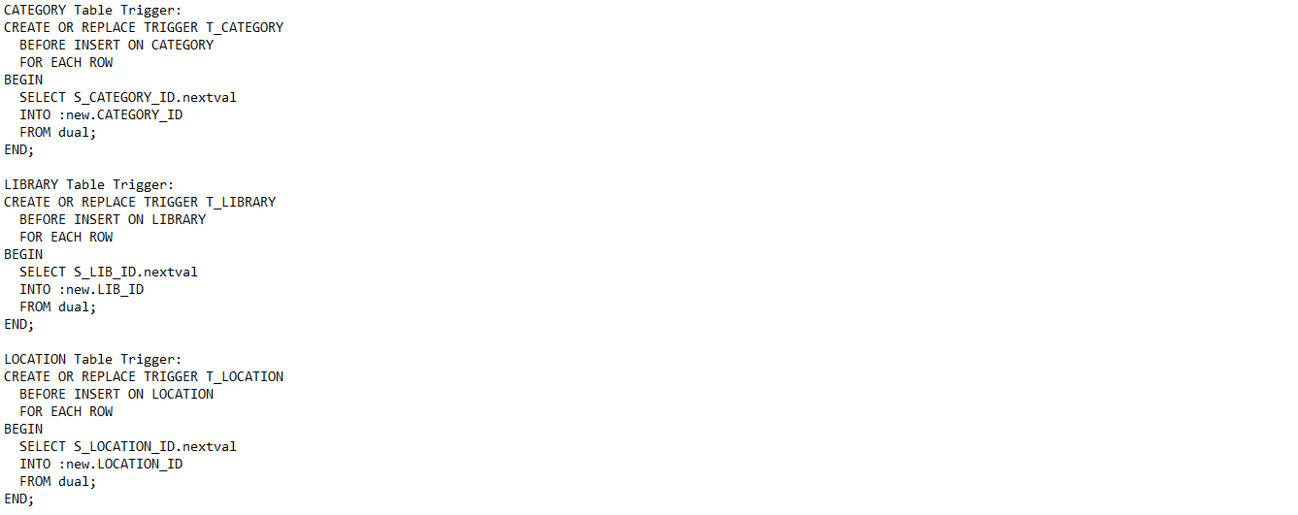
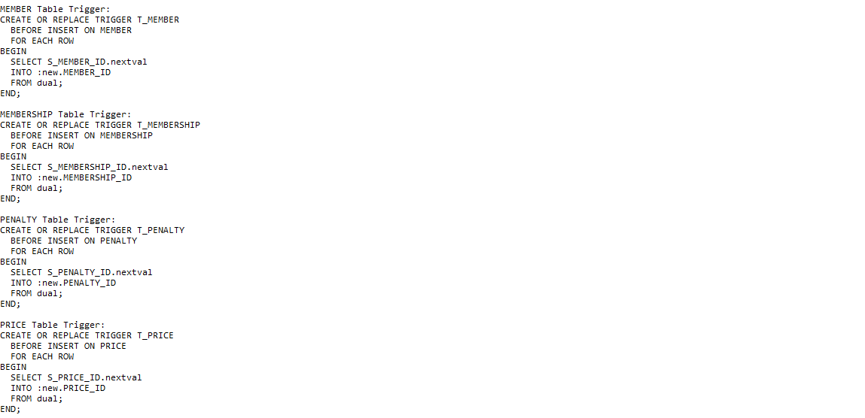

Slide 18
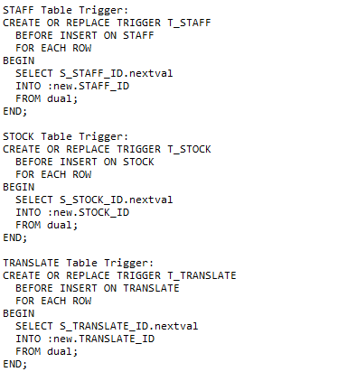

Slide 19
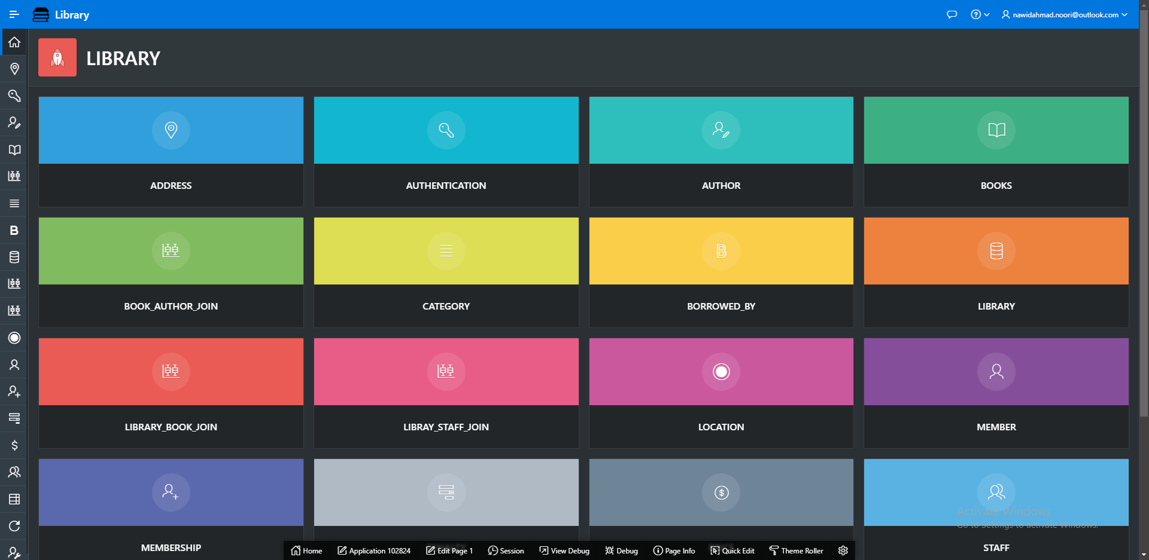
The 8th step in the database was to create front end by using apex application builder

Slide 20
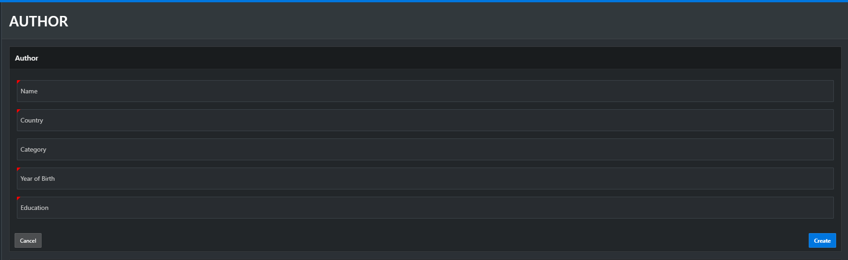
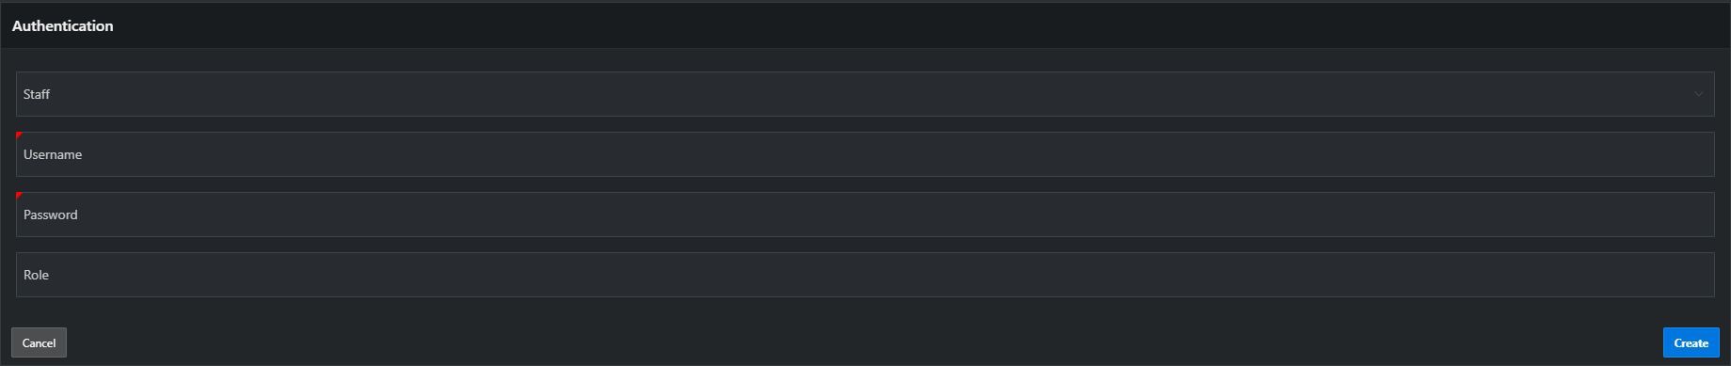
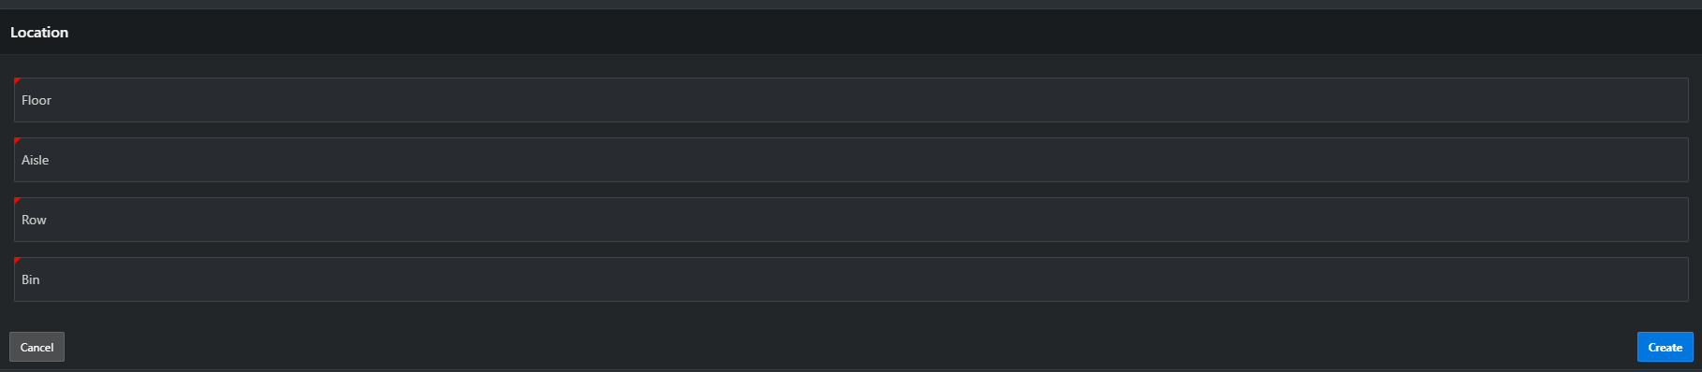
Forms for Insert , Update and Delete records

Slide 21
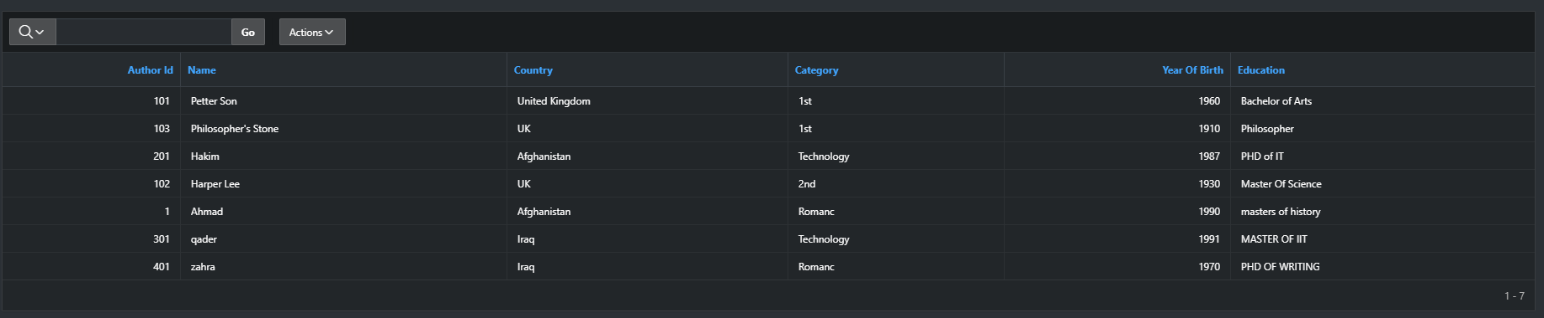
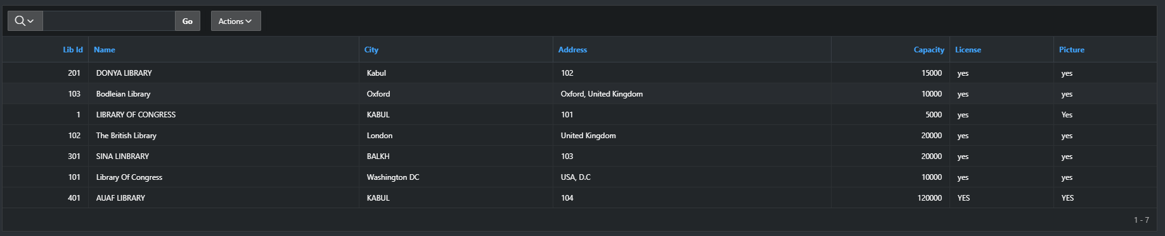
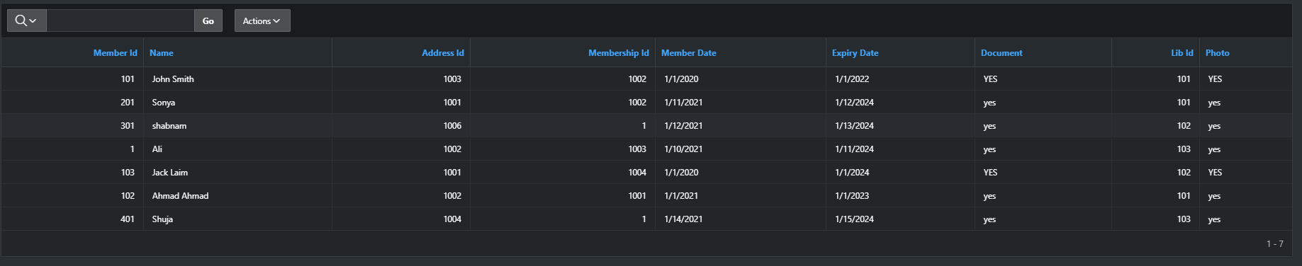
Reports

Slide 22
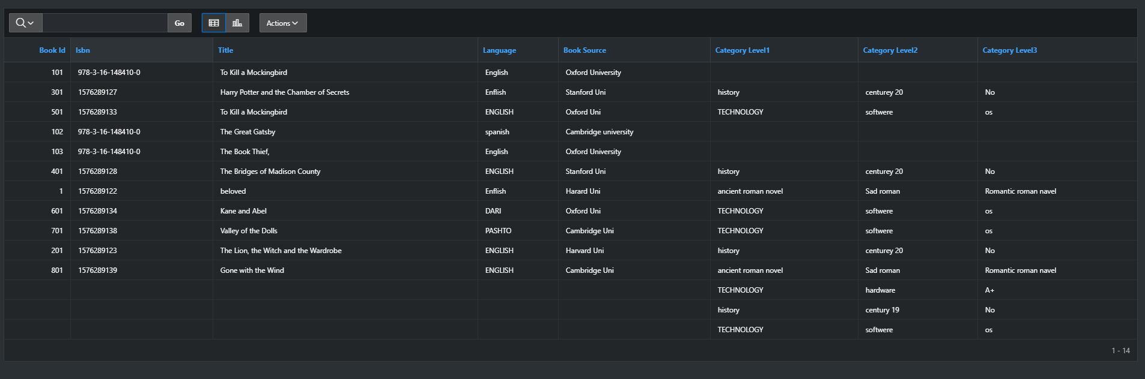
Report which get data from many tables

Slide 23
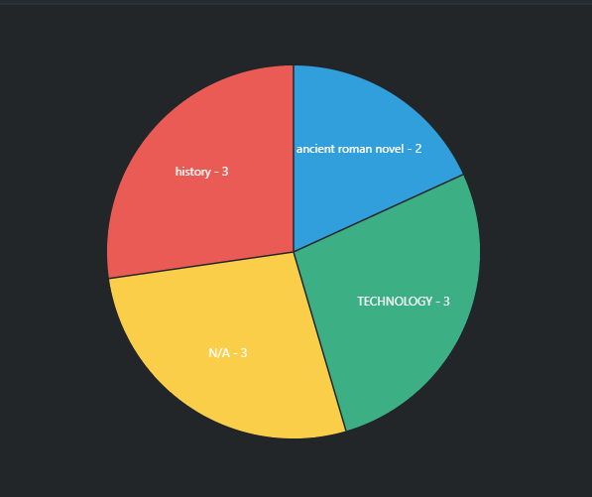
Charts for data analyzing

Slide 24
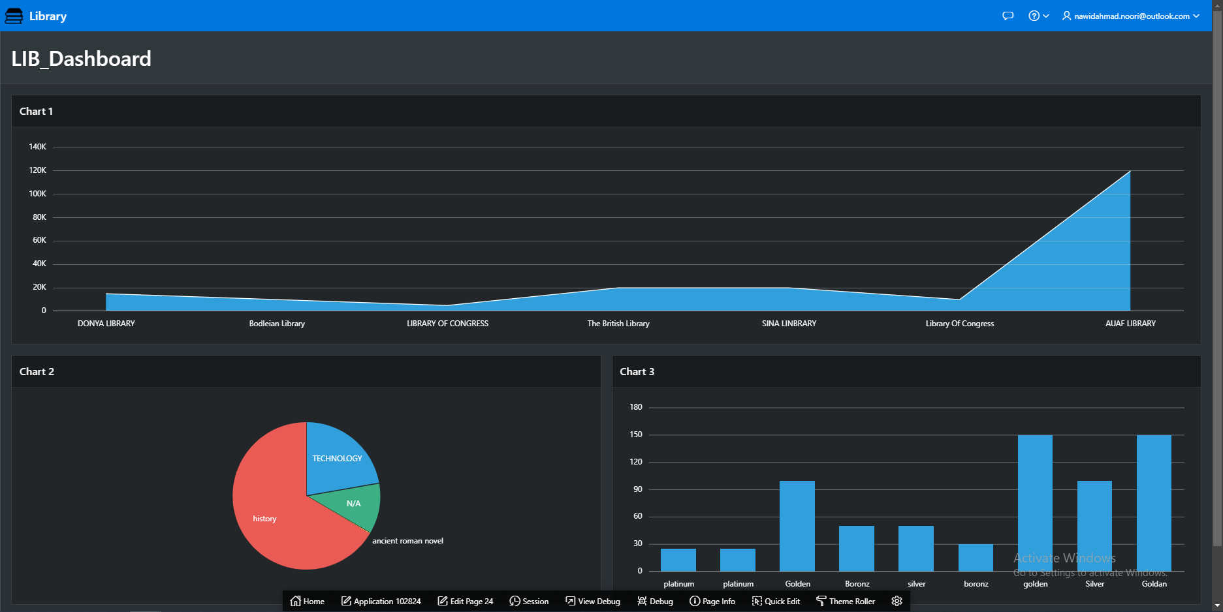
Dashboards
Charts for data analyzing

Slide 25


